Slide 1
High alpha power at O1

Slide 2
Low alpha power at O1

Slide 3
High alpha power at Pz

Slide 4
Low alpha power at Pz

Slide 5
Green

Slide 6
High alpha power at Pz

Slide 7
Low alpha power at Pz

Slide 8
Blue

Slide 9
Red

Slide 10
Overall
Yellow 2 Cyan (Green)
Cyan 2 Magenta (Blue)
Magenta 2 Yellow (Red)

Slide 11
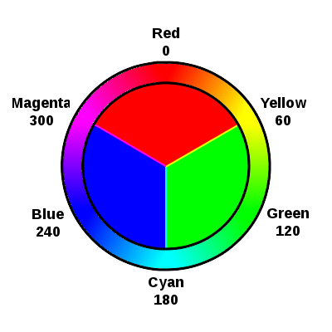
Overall
Yellow 2 Cyan (Green)
Cyan 2 Magenta (Blue)
Magenta 2 Yellow (Red)

Slide 12
Overall
Yellow 2 Cyan (Green)
Cyan 2 Magenta (Blue)
Magenta 2 Yellow (Red)

Slide 13
Overall
Yellow 2 Cyan (Green)
Cyan 2 Magenta (Blue)
Magenta 2 Yellow (Red)

Slide 14
Overall
Yellow 2 Cyan (Green)
Cyan 2 Magenta (Blue)
Magenta 2 Yellow (Red)

Slide 15
Overall
Yellow 2 Cyan (Green)
Cyan 2 Magenta (Blue)
Magenta 2 Yellow (Red)

Slide 16
Overall
Yellow 2 Cyan (Green)
Cyan 2 Magenta (Blue)
Magenta 2 Yellow (Red)

Slide 17
Overall
Yellow 2 Cyan (Green)
Cyan 2 Magenta (Blue)
Magenta 2 Yellow (Red)

Slide 18
Overall
Yellow 2 Cyan (Green)
Cyan 2 Magenta (Blue)
Magenta 2 Yellow (Red)

